Slide 1
Rhodium paper figure sequence
8/6/2019

Slide 2
System
Old hypothesis didn’t show much difference:
Two harvesters – one harvests prey, one harvests predator – only have access to their last harvest as input
Two harvesters – one harvests prey, one harvests predator –have access to their own and of the others last harvest as input
Both formulations have min population thresholds where both harvesters stop operating when crossed.

Slide 3
System
Two harvesters – one harvests prey, one harvests predator –have access to their own and of the others last harvest as input
There is min population thresholds where both harvesters stop operating when crossed.
Policy strategy is Direct Policy Search
Paper objectives:
Demonstrate how Rhodium can be used for MORDM analysis
Demonstrate how Rhodium can facilitate in the negotiated identification of management strategies
Demonstrate the system implications of strategies selected via multiple metrics

Slide 4
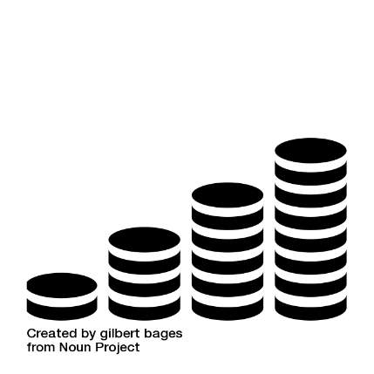
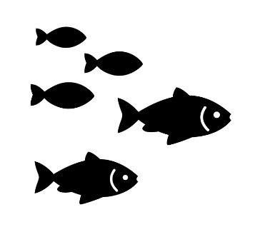

Objectives
Averaged over 100 realizations of well-characterized environmental stochasticity
Net Present Value for prey harvester
Total discounted profits
Prey deficit
Deficit from population capacity
Net Present Value for predator harvester
Total discounted profits
Predator deficit
Deficit from population capacity

Slide 5
Optimization
Using BorgMOEA (PyBorg through Rhodium)
10000 NFE
Epsilons: 10 for each NPV objective, 0.01 for each deficit objective
1 seed
Questions:
Variance minimizing objective?
Random seed analysis for the supplement
More NFE?

Slide 6
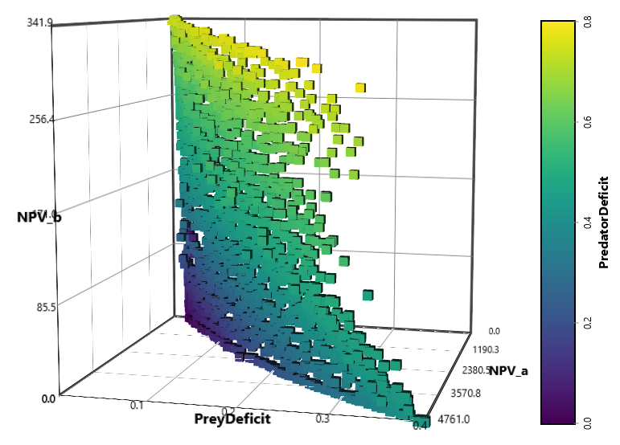
Tradeoffs

Slide 7
Negotiated selection of management strategies
No regulation:
Prey harvester A has more control over system (need to demonstrate that either analytically or through graphs) and selects NPVa maximizing solution
Regulation to protect interests of B and species populations:
Fallback bargaining where a solution is identified to be in the top X number of management strategies for all interests

Slide 8
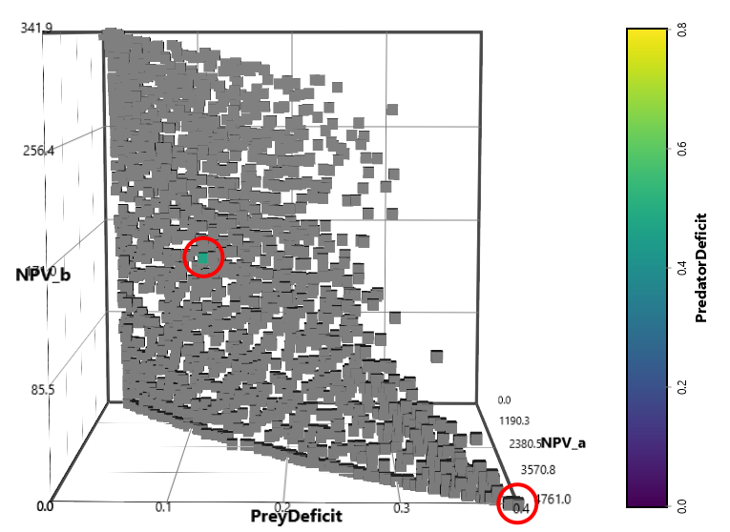
Objectives compromise solution
NPVa maximizing solution

Slide 9
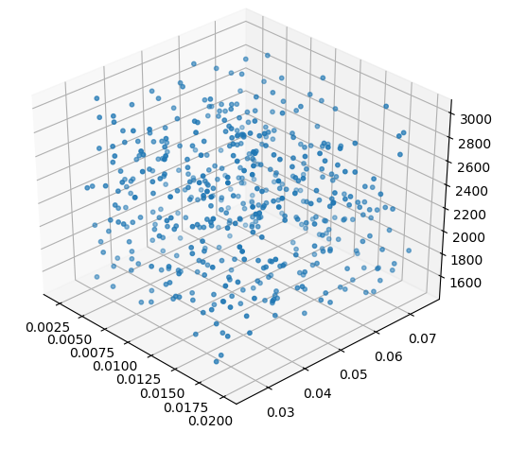
Reevaluating for uncertainty
Latin Hypercube Sampling: 500 combinations
Parameter | Min. | Default | Max.
α | 0.002 | 0.005 | 0.05
b | 0.01 | 0.5 | 1
K | 1000 | 2000 | 4000
m | 0.1 | 0.7 | 1.2
K
a
b

Slide 10
Assess performance under deep uncertainty
Satisficing:
Percentage of SOWs where each criterion is met:
NPVa >= 1200
NPVb >= 120
Prey def. <= 0.5
Predator def. <= 0.5
Regret:
90th percentile of absolute deviation for the worse from baseline performance at each objective

Slide 11
Negotiated selection of management strategies under uncertainty
No regulation:
Solution with best NPVa satisficing
Solution with least NPVa regret
Regulation to protect interests of B and species populations:
Fallback bargaining for solutions maximizing satisficing of all criteria
Fallback bargaining for solutions minimizing regret of all criteria

Slide 12
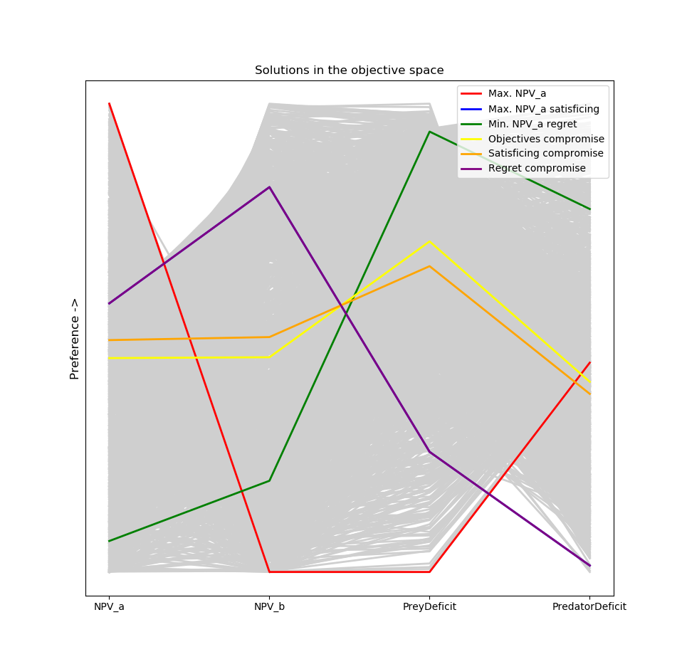
Solutions in the objective space

Slide 13
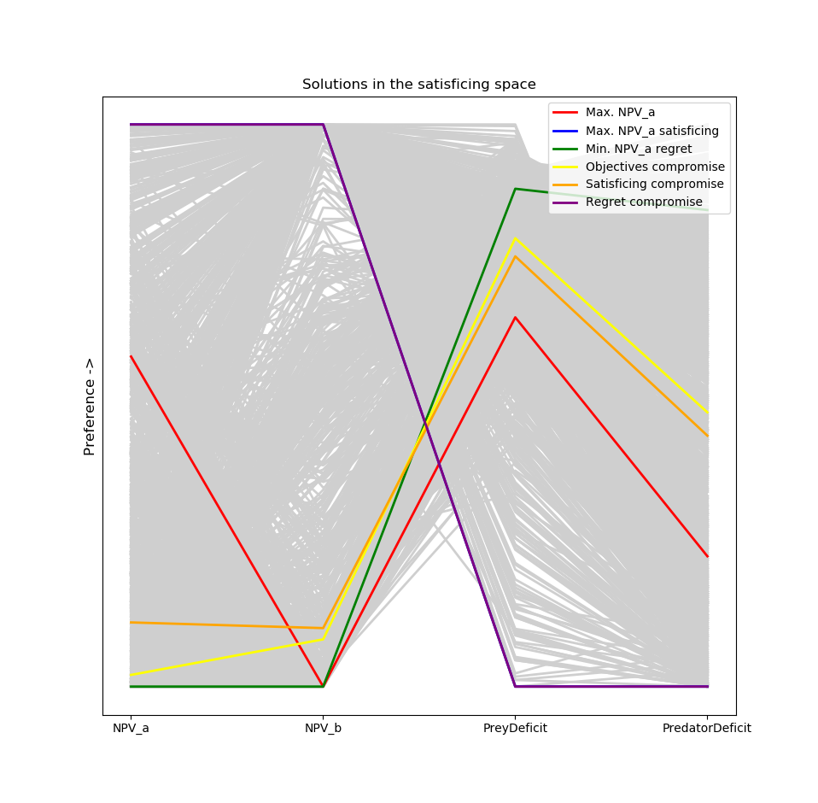
Solutions in the satisficing space

Slide 14
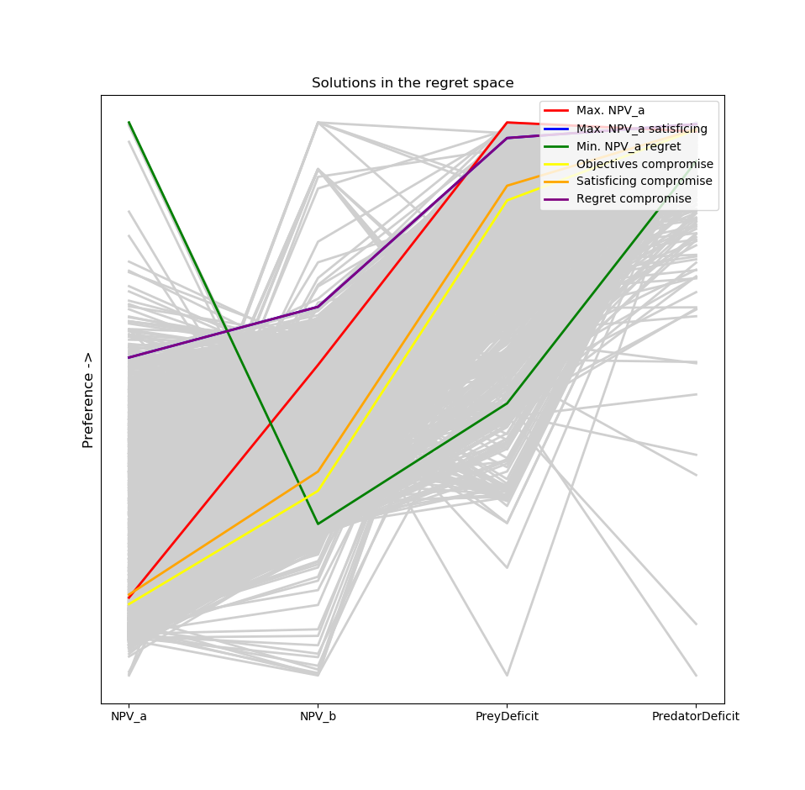
Solutions in the regret space

Slide 15
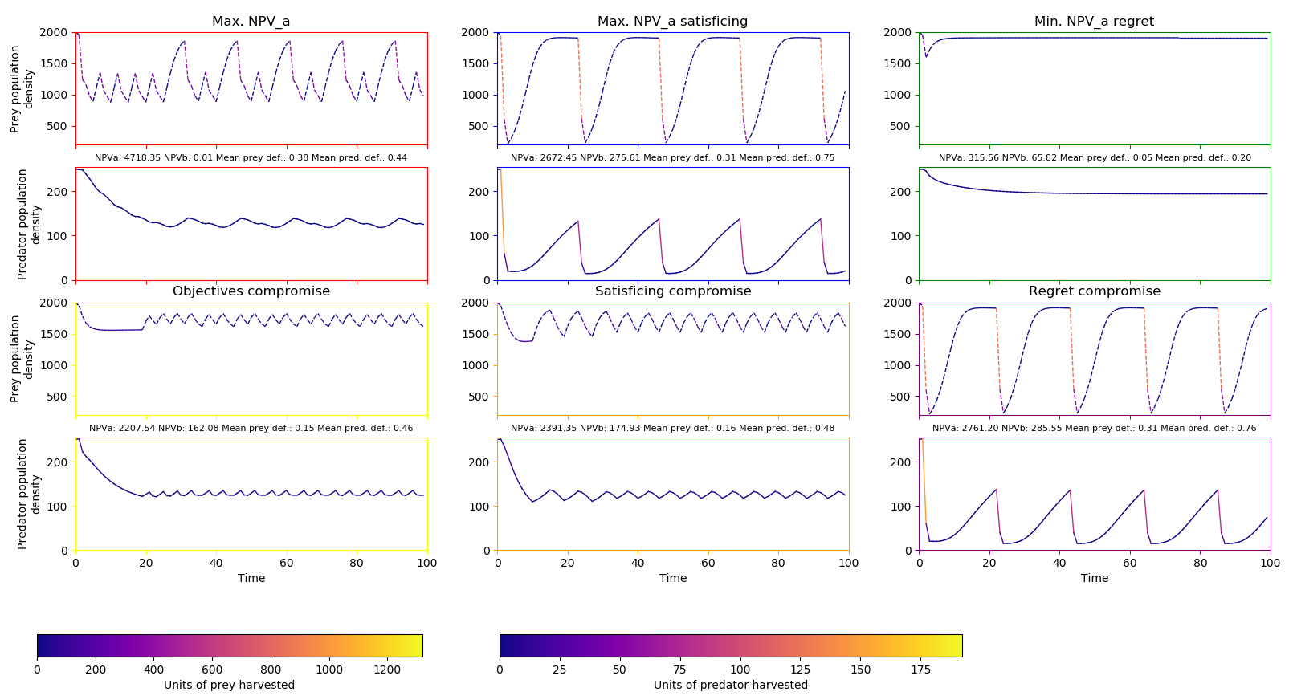
Policy diagnostics

Slide 16
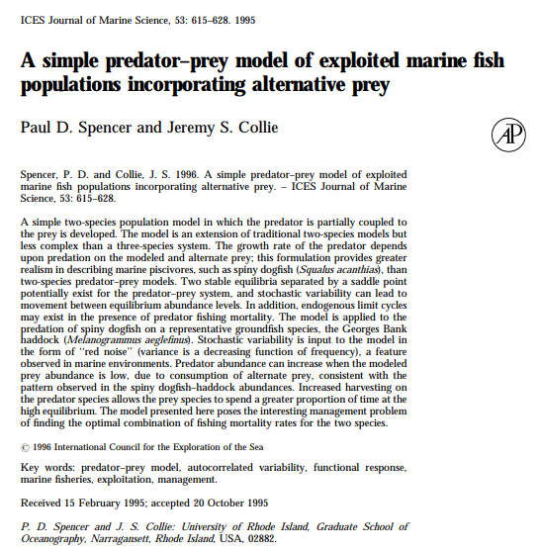
Finding a real-world parallel
Predator: spiny dogfish
Prey: haddock
Yearly parameter values:
Prey growth rate (b): 0.66-0.9
Prey encounter rate (a): 3
Predator conversion (c): 0.06
Predator growth rate (a*c): 0.18
K=850

Slide 17
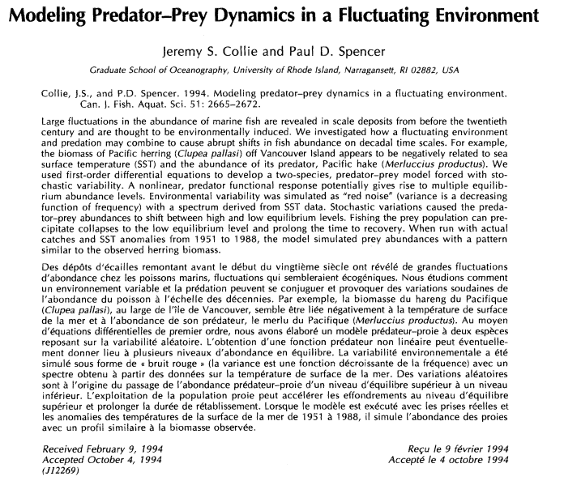
Finding a real-world parallel
Predator: Pacific hake
Prey: Pacific herring
Yearly parameter values:
Prey growth rate (b): 0.9-1.1
Predator growth rate (a*c): 0.5-0.6
K=250

